Slide 1
My Journey of Latin
By Angel Tin

Slide 2
Angel Tin
ENGE/4 (Class of 2017)
Catholic
Telegram: @tinkawai

Slide 3
CUHK Latin Classes
Medieval Latin
Introductory Latin
Harder?
Less time to go through basics
More textual study
Easier?
Starting from Basic
More on grammatical items

Slide 4
MY 1-YR LATIN STUDY @UofSC, USA
Department of Classics
Greek
Latin
Mythology
Classes Taken
Elementary Latin (Term 1)
Basic Proficiency of Latin (Term 2)
Virgil (Dropped )

Slide 5
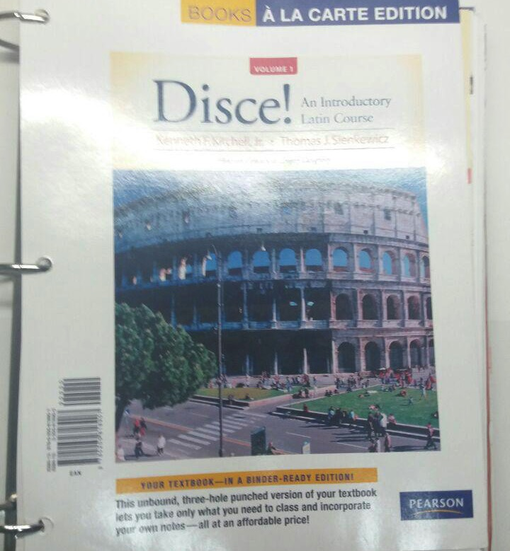
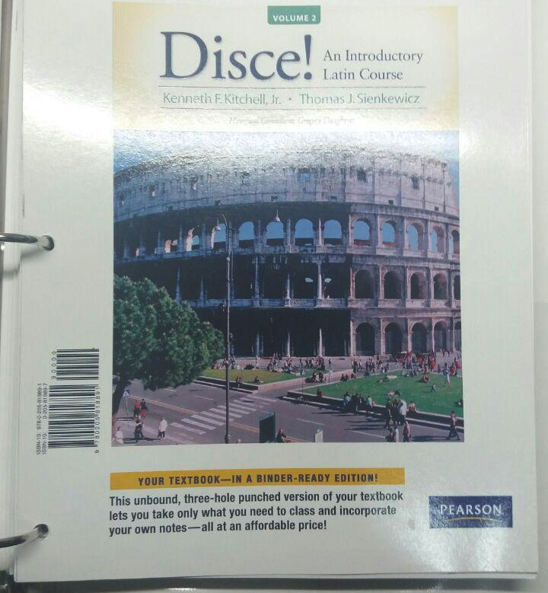

Slide 6
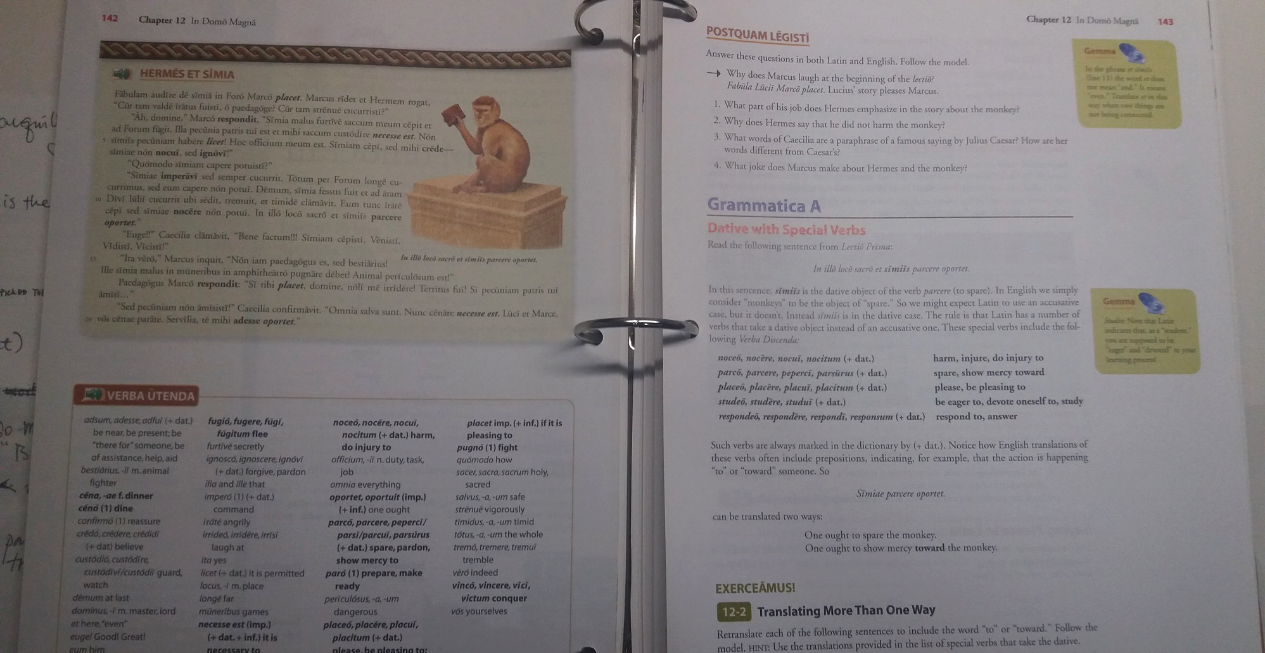

Slide 7
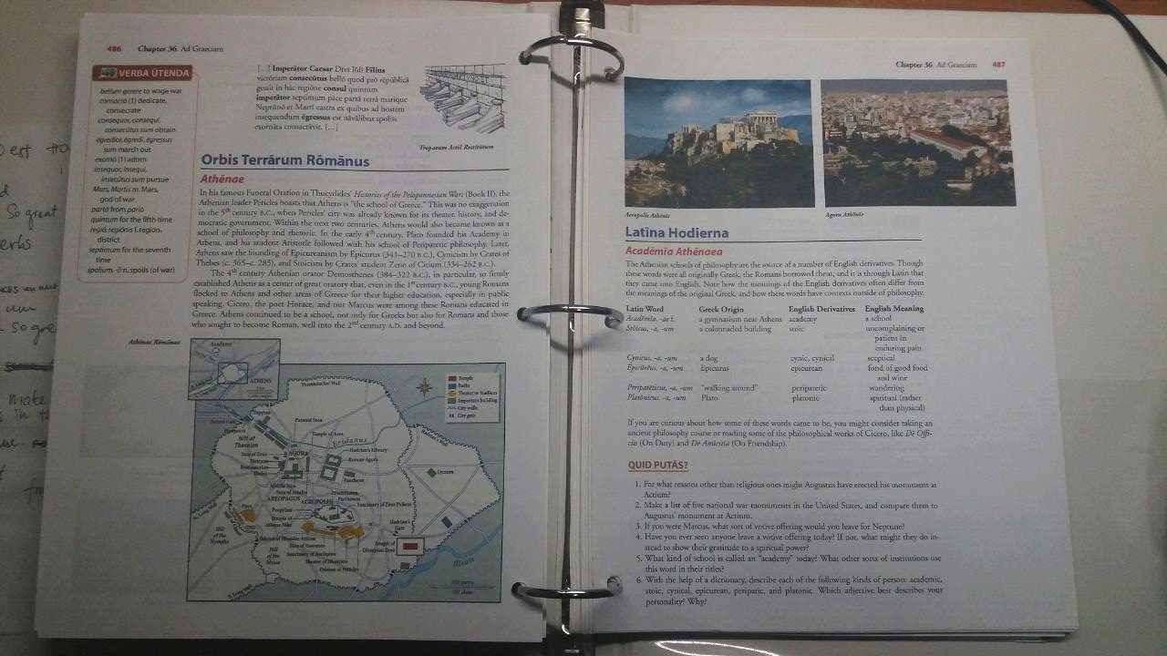

Slide 8
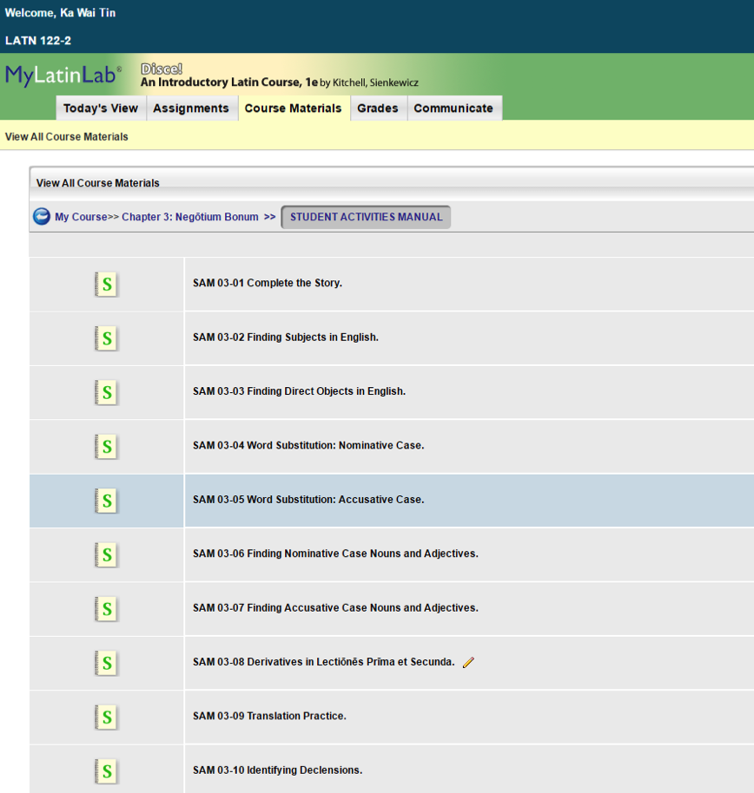
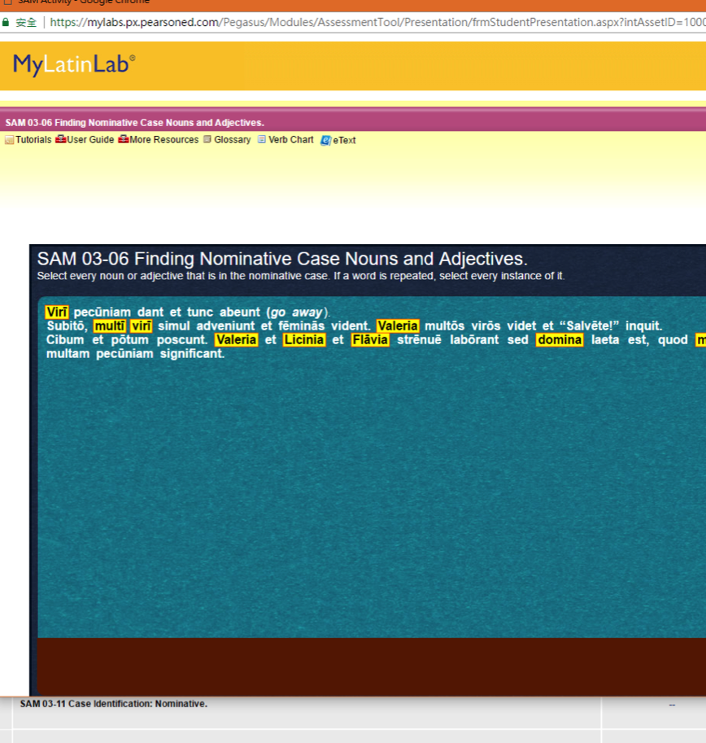

Slide 9
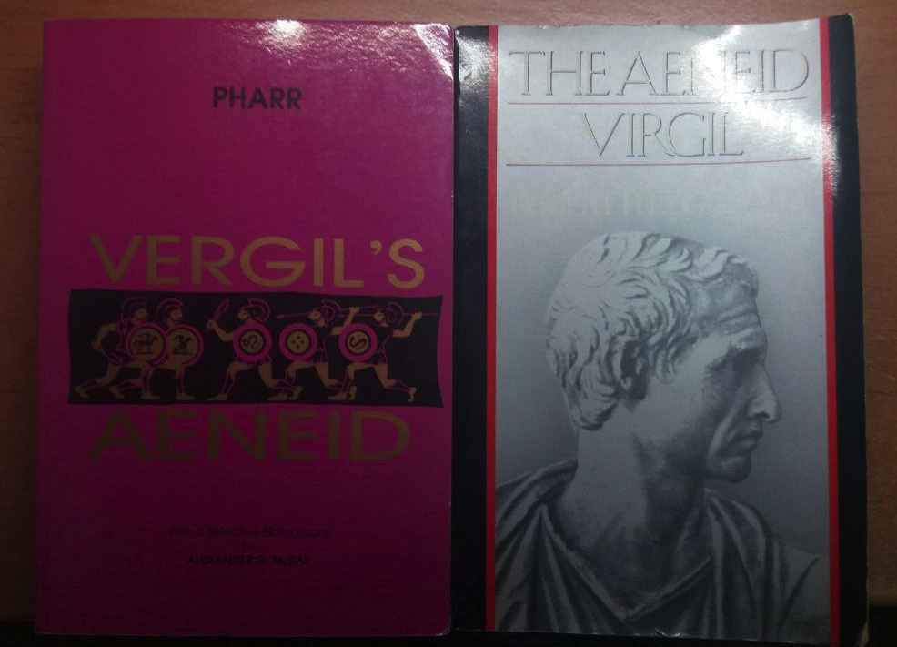

Slide 10
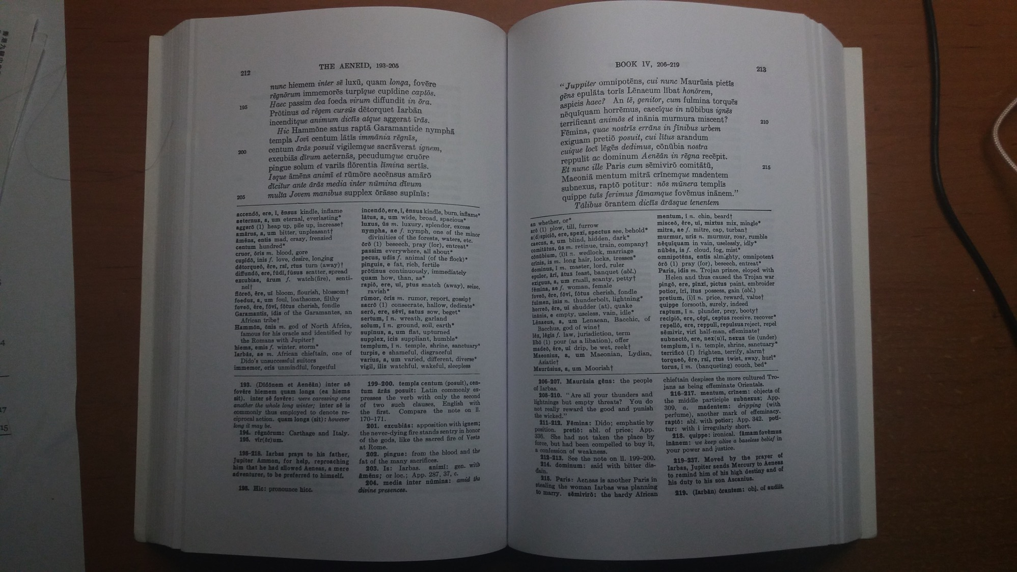

Slide 11
Study Tips Latin is definitely not easy, but fun ;)
Try to Find its Underlying Pattern
Tons(?) of patterns (and sometimes exceptions) to be noticed
Just like English haha
Keep Practicing T____T
Keep copying and reciting @.@
Keep being exposed with Latin words
Religious Text?
School/ Army/ State Mottos?
South Carolina State Motto:
Animis Opibusque Parati (Prepared in Mind and Resources)
Dum Spiro Spero (When I breathe, I hope.)

Slide 12
Thank You
Reach me on Telegram @tinkawai

